Slide 1
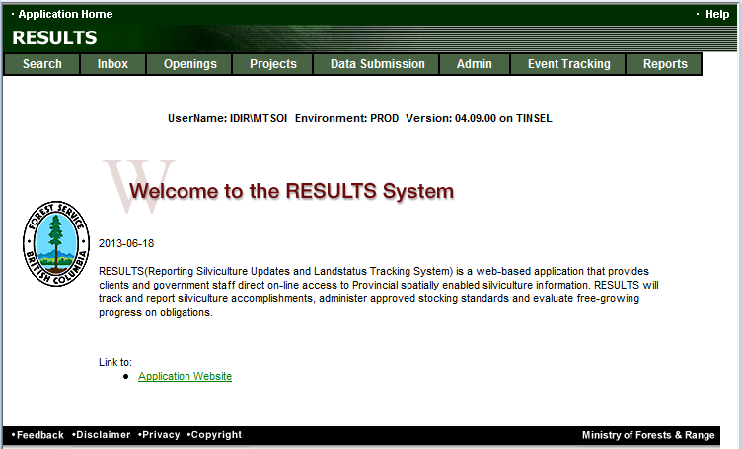
RESULTS Training
Core Module 5
Obligation Reporting
Standards Unit Modifications-ESF
Sept 2013

Slide 2
Learning Objectives
Business Guidelines
Online or ESF Matrix
Technical documentation references
ESF Process
What kind of Plan?
    Corrections
    Minor Amendment
    S197
    Approved Variation
    Site Plan Amendment
    Amendment requiring Approval
    Inbox Approval
Auditing SU Modifications
Help Resources

Slide 3
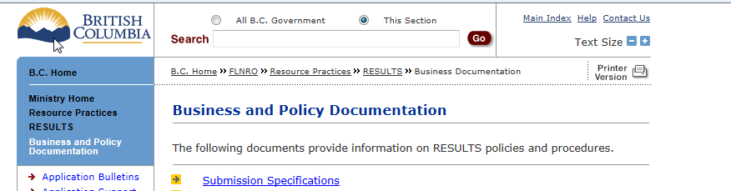
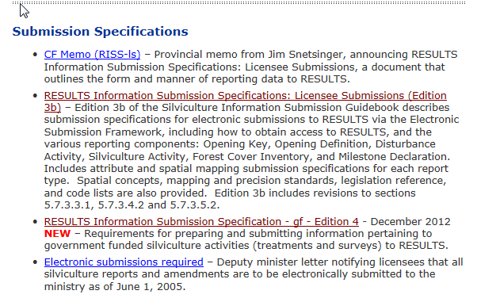
Business Guidance
http://www.for.gov.bc.ca/his/results/business.htm

Slide 4
Online or ESF Matrix
Submission Component | ESF | Online
\Opening Definition Tenure & Site Plan Information | Yes | No Opening and Standards Unit Spatial required
SU Modifications* | Yes | Conditional Must use ESF where there is changes to Standards Unit (additions, deletions) or changes in spatial.
Disturbance | Yes | Yes
Silviculture Activity | Yes | Yes Mandatory ESF for government funded activities (FE, JS)
Forest Cover * | Yes | No Forest Cover Spatial required
Milestone | Yes | Yes
s.108 Application | No | Yes
* Any spatial requirements must be submitted by ESF

Slide 5
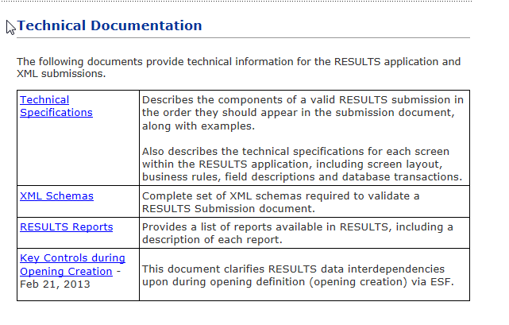
Technical Documentation References http://www.for.gov.bc.ca/his/results/techDocs.htm

Slide 6
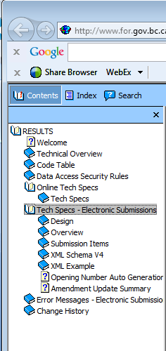
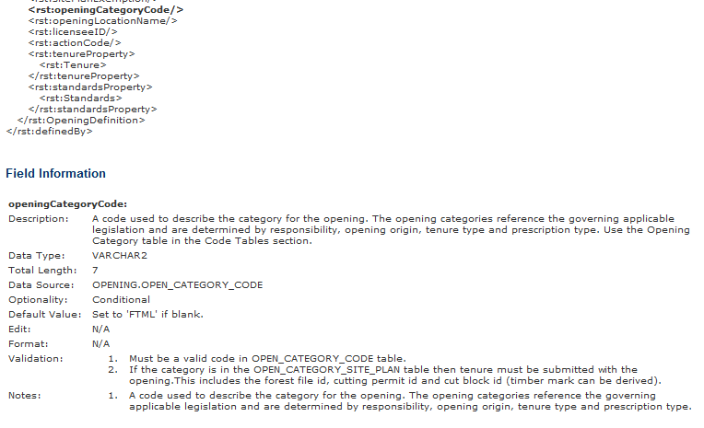
Technical Documentation ESF Schema References
http://www.for.gov.bc.ca/his/results/techDocs.htm
Tech Specs has ESF Reference with business rules and field specific edits.
Reference is by schema item.

Slide 7
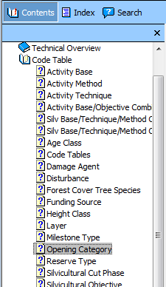
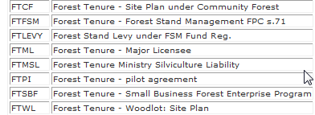
Technical Documentation Codelists
http://www.for.gov.bc.ca/his/results/techDocs.htm

Slide 8
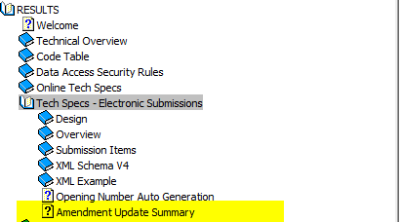
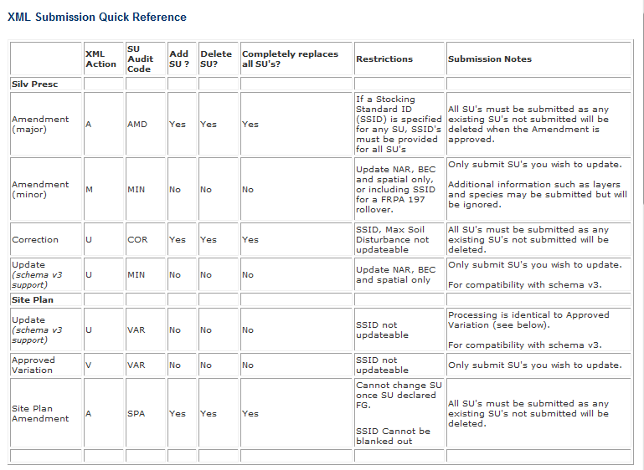
Technical Documentation SU Modifications Cheatsheet
http://www.for.gov.bc.ca/his/results/techDocs.htm
Helps explain setup for ESF portion
“A” and “U” actions with inclusion or omission of SU implies addition or removal of SUs!

Slide 9
RESULTS – ESF Process
ESF
Type | ESF Action Code | Audit Event Action
Silv Prescription
Correction | U | COR Correction
Minor | M | MIN Amended Minor
S197 | M¹ | S197 Section 197
Major Amendment | A | AMD Amended
Site Plan
Approved Variation | V | VAR Variation
Site Plan Amendment | A | SPA Site Plan Amendment
S197 | A¹ | S197 Section 197
¹197 is subject to pre-condition in FSPTS use of SS ID associated with FSP with 197 Election Box Checked in the FSPTS.

Slide 10
RESULTS – General Process
Who | Process
Submitter | What type of Plan?
 | What type of Change?
 | Make Changes & provide any supplemental information
 | Submit / Save Changes
MOFR Approver | Review to Approve or Not Approve

Slide 11
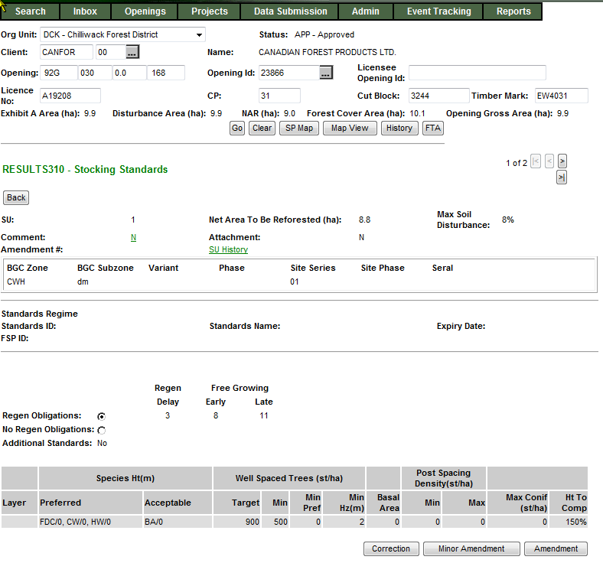
RESULTS – 1) What type of Plan?
Silviculture Prescription
S310 Stocking Standards
No Standards ID
Applies to ML Silviculture Prescription or WL Site Plan

Slide 12
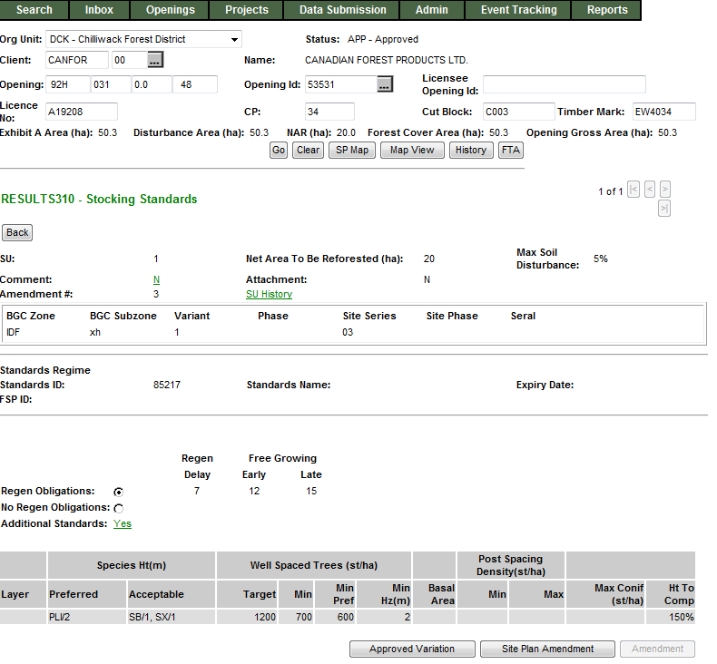
RESULTS – 1) What type of Plan?
Site Plan
S310 Stocking Standards
Standards ID exists
Applies to ML Site Plan or Woodlot Pre-Harvest Maps, and FFT Treatment Prescriptions

Slide 13
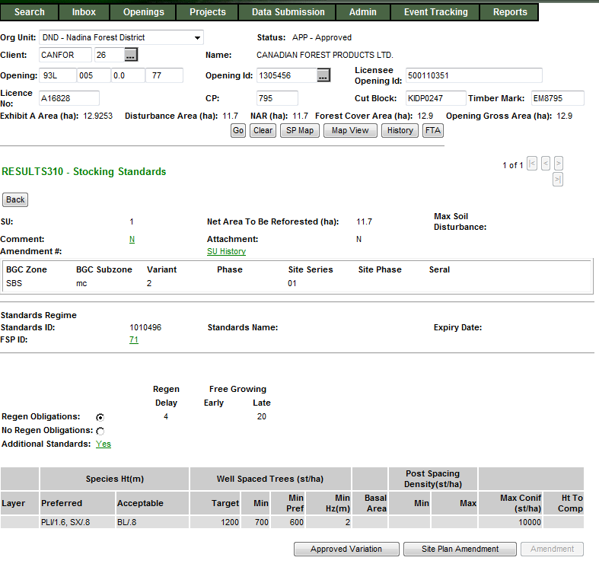
RESULTS – 1) What type of Plan?
FSP Site Plan
S310 Stocking Standards
Standards ID exists
Applies to ML Site Plan where the Standards ID is associated with FSP
Link exist to view details about FSPTS if have authorization

Slide 14

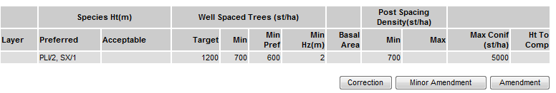
RESULTS – 2) What type of change?
Silviculture Prescription
  Corrections (for correcting paper-based pre-ESF records)
  Minor Amendments (No Approval Required)
  S197 (No Approval Required)
  Major Amendments (Approval Required)

Slide 15
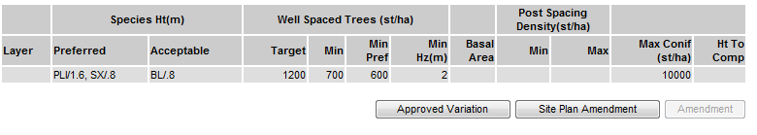
RESULTS – 2) What type of change?
Site Plan
Approved Variations (No Approval Required)
  S197 (No Approval Required)
Amendments (No Approval Required)

Slide 16
RESULTS – Corrections
Business
  Intended to correct opening SUs entered during paper-based data entry (records pre-mandatory ESF prior to June 1, 2005)
  Corrections are to reflect legal approved documents that exists.
  Older records do not have online SP Maps (unless converted through RESULTS Opening Spatial Conversion process) and therefore making changes not require spatial; but you can always include (but then must be via ESF)

Slide 17
RESULTS – Corrections
ESF function
Action Code “U” - Update
  Must include ALL SU’s even for those SU with no change
  Missed SU is assumed as a deleted SU
  New SU is assumed new SU
  Missing data elements for any SU will appear as blanks
  SS ID is not updatable
  Provide rationale
Spatial may be updated to provide missing spatial (pre-2005 records).
All changes are audited via SU History and History

Slide 18
RESULTS – ESF Corrections
Sequence | Action Code | SU’s
Original Opening |  | 1, 2, 3
ESF Submission | “U”-Update with changed values for each SU | 1, 2, 3
Outcome | Correction | 1, 2,3 with updated changes reflected
Sequence | Action Code | SU’s
Original Opening |  | 1, 2, 3
ESF Submission | “U”-Update with changed values for each SU | 2, 3, 4
Outcome | Correction | 2,3 with updated changes reflected SU 1 is deleted 4 is a new SU
No SS Regime ID is allowed to be added under Correction
Updated spatial can be submitted for with SU’s

Slide 19
RESULTS – Minor Amendment
Business
  Intended for making area adjustments based on better information from field surveys.
ESF function
Action Code “M” – Minor
Only submit for the SU you wish to update
Any additional information submitted such as layers and species maybe submitted but ignored with exception of SS ID which is assumed to be tied to potential s197 rollover
Only BEC and NAR updateable when associated with Minor amendment
Provide Rationale
All changes are audited via SU History and History

Slide 20
RESULTS – Minor Amendment
Sequence | Action Code | SU’s
Original Opening |  | 1, 2, 3
ESF Submission | “M”-Minor with changed values for each SU | 2
Outcome | Minor Amendment | Only SU 2 is changed
BEC and NAR can be updated
No updates to specific stocking standards
Spatial can be updated
SS Regime ID can only be added for s.197 scenario

Slide 21
RESULTS – FRPA s.197 (Silv Prescription)
Business
s.197 rollover requires no approval required as it has been already approved under FSP.
Standards Regime ID (SS ID) updatable and recognize as s197 rollover only if all of the following conditions are met:
Allowed for Silviculture Prescription or Site Plan not associated with a FSP
Standards ID being applied is associated with a FSP that has s197 Election Checked (“Y”) in the FSPTS
Standards ID belongs to the client and org unit for the FSP

Slide 22
RESULTS – FRPA s.197 (Silv Prescription)
ESF function
  Action Code “M” – s197 (interpreted as 197 under specific conditions)
  Provide SS ID associated with FSP with 197 Election Selected in the FSPTS
  Provide rationale

Slide 23
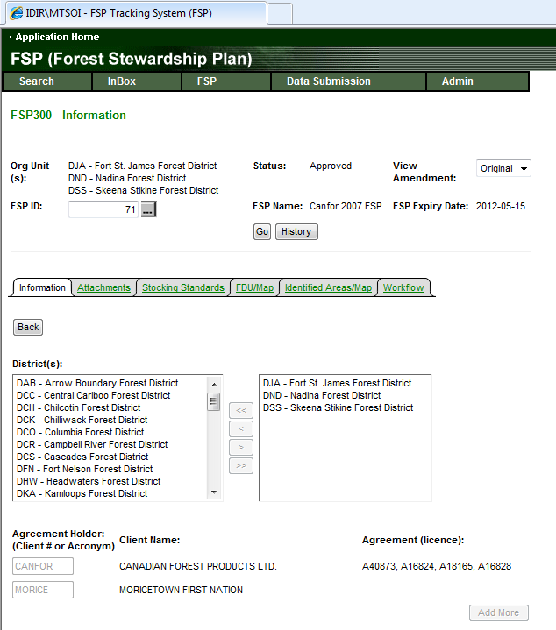
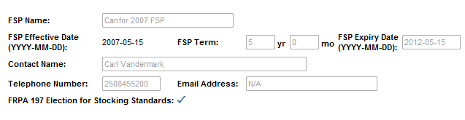
RESULTS – FRPA s.197
FRPA s197 Election must be made using FSPTS in order for s197 rollover to work in RESULTS

Slide 24
RESULTS – s.197
Sequence | Action Code | SU’s
Original Opening |  | 1, 2, 3
ESF Submission | “M”-Minor include SS Regime ID must be associated with FSP that has FRPA 197 election checked | 2
Outcome | s197 | Only SU 2 is changed with SS ID and has reference to FSP ID
BEC and NAR can be updated
No updates to specific stocking standards
Spatial can be updated
SS Regime ID can only be added for s.197 scenario

Slide 25
Approved Variation
Business
Intended for changes to stocking standards based on approved variations as per Forest Stewardship Plan.
ESF function
Action Code “V” – Approved Variation
Only submit SU you wish to update
SS ID is not updatable
Provide rationale
All changes are audited via SU History and History

Slide 26
RESULTS – Approved Variation
Sequence | Action Code | SU’s
Original Opening |  | 1, 2, 3
ESF Submission | “V”-Approved Variation SS ID not updatable | 2
Outcome | Variation | Only SU 2 is changed with changes to specific stocking standards per FSP approved variation
BEC and NAR can be updated
No Changes allowed to SS Regime ID
Make changes to specific components of the stocking standards as per FSP approved variation
Spatial can be updated

Slide 27
FDP Site Plan FRPA s.197 over to FSP
Business
  S197 rollover FDP site plans to FSP site plans
ESF function
  Action Code “A” – Site Plan Amendment
  Must submit all SUs
  Cannot change SU once declared FG
  SS ID Mandatory
  Provide SS ID associated with FSP with 197 Election Selected in FSPTS
  Any missing SU will be deleted
  Can provide rationale comments
  All changes are audited via SU History and History

Slide 28
RESULTS – FDP Site Plan s197 rollover
Sequence | Action Code | SU’s
Original Opening |  | 1, 2, 3
ESF Submission | “A”-Amendment SS ID updatable and link to FSPTS with Election Indicator checked | 1, 2, 3
Outcome | S197 Rollover | All 1, 2, 3 has been switched to FSP Site Plan
BEC and NAR can be updated
Changes allowed to SS Regime ID, BEC and NAR
SS Regime ID must be approved for use by client and org unit, exist in FSP and FSP s197 Election has been checked
Spatial can be updated

Slide 29
Site Plan Amendment
Business
  Amendment to site plans – can add, delete or modify Standard Unit information and SS ID.
ESF function
  Action Code “A” – Site Plan Amendment
  Must submit all SUs
  Cannot change SU once declared FG
  SS ID Mandatory
  Any missing SU will be deleted
  Can provide rationale commentsAll changes are audited via SU
  History and History

Slide 30
RESULTS – Site Plan Amendment
Sequence | Action Code | SU’s
Original Opening |  | 1, 2, 3
ESF Submission | “A”-Amendment SS ID updatable | 2, 4
Outcome | Amendment | Only SU 2 is changed. Note that 1 and 3 is deleted. New SU 4 is created.
BEC and NAR can be updated
Changes allowed to SS Regime ID, BEC and NAR
Spatial can be updated

Slide 31
Silviculture Prescription Amendment (Requiring Approval)
Business
  Requiring changes to silviculture prescription.
ESF function
  Action Code “A” – Amendment
  All Standard Units (SU) must be submitted with same identifiers.
  If omit SU, assumed deletion. If change SU Identifier assume as new SU.
  Any elements that differ for a given SU is assumed proposed amendment for approval.
  Cannot change SU once declared FG
  ESF Submission of Silviculture Prescription Amendments automatically becomes an Opening in “SUB” – Submitted Status awaiting for Inbox Processing.
  Unable to recall amendment after submission. If there is a requirement to change, must make request to District contact to Not Approve amendment in order to resubmit.
  All changes are audited via SU History and History

Slide 32
RESULTS – Amendment requiring approval
Sequence | Action Code | SU’s
Original Opening |  | 1, 2, 3
ESF Submission | “A”-Amendment with changed values for each SU | 1, 2, 3
Outcome | Amendment | 1, 2,3 with updated changes reflected
Sequence | Action Code | SU’s
Original Opening |  | 1, 2, 3
ESF Submission | “A”-Update with changed values for each SU | 2, 3, 4
Outcome | Amendment | 2,3 with updated changes reflected SU 1 is deleted 4 is a new SU
ESF submission of Amendment will change the Opening Status to “SUB” – amendment is submitted and awaits Ministry’s review and approval. Only when the Opening is approved and then the requested changes are reflected in the Opening.

Slide 33
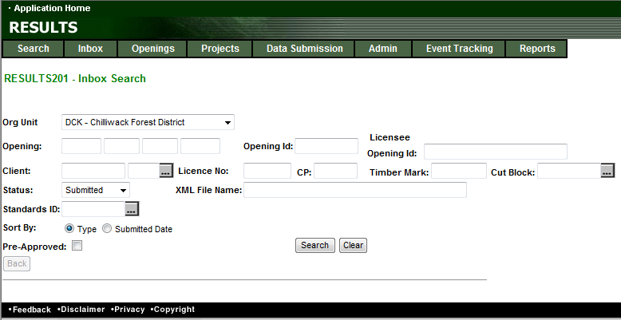
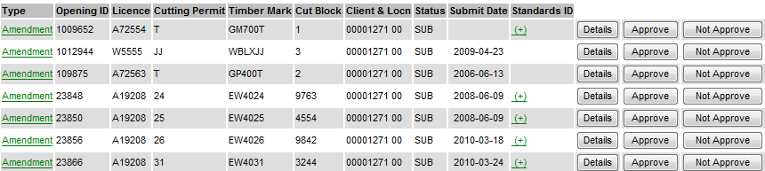
RESULTS –Amendment requiring Approval
Inbox – RESULTS Approver role
S201 – Inbox Search
MOF personnel must have “Approver” role to action.
Set Status to “SUB” & Search
“SUB” status will not allow declaration and any attempt for any other SU modifications due to pending review.

Slide 34
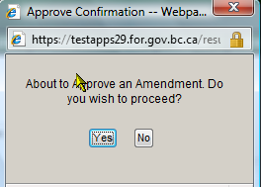
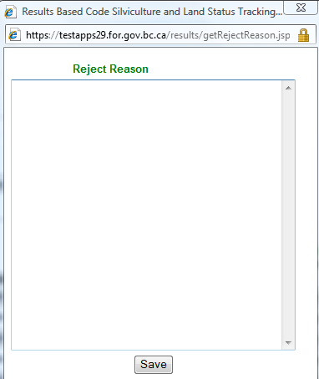
RESULTS –Amendment requiring approval
Inbox – RESULTS Approver role
S201 – Inbox Search
Ministry personnel must have “Approver” role to action.
Details Take to S310 – to enable review of Submitted Proposal.
Approve Will approve Submitted Amendment –
Opening will change from “SUB” to “APP” status
-----------------------------------------------------------------------------------------------------------------
Not Approver: Requires mandatory reason to explain reason for not approval.
Approve Opening change from “SUB” to “AMD”
Submitter: Make decision for next step:
Delete Amendment – change from “AMD” status to “APP” to start over
Modify existing Proposed Amendment to resubmit – change from “AMD” to “SUB”

Slide 35
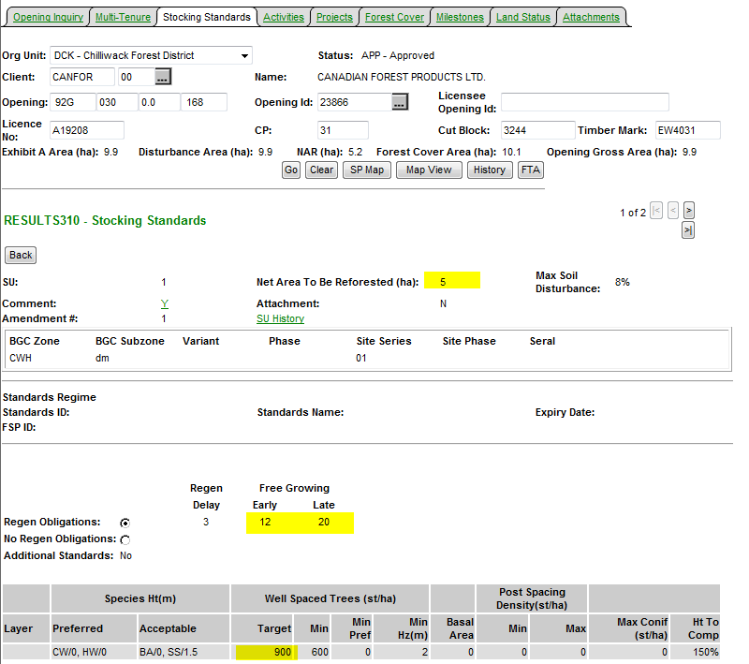
RESULTS –Amendment requiring approval
Inbox – Approved Opening
Upon Approval – Status changed to “APP”
All changes from the Amendment is now reflected current S310-Stocking Standards.
SU History & History contains Audited changes.

Slide 36
Steps for ESF Major Amendment
Approve
APP
SUB
APP
Changes reflected and audited*
Not Approve
AMD
No changes reflected
Submitter to respond
As required on their respective forest management system
*Auditing is done through SU History AND History (Event)

Slide 37
Auditing – SU History
SU History Tracks all SU Modifications since March 2008

Slide 38
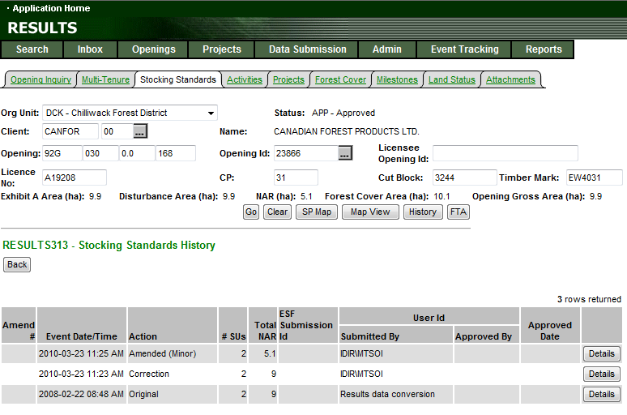
Auditing – SU History
All records will have either “O” original or “ES”
As the baseline condition
to use as basis for comparison

Slide 39
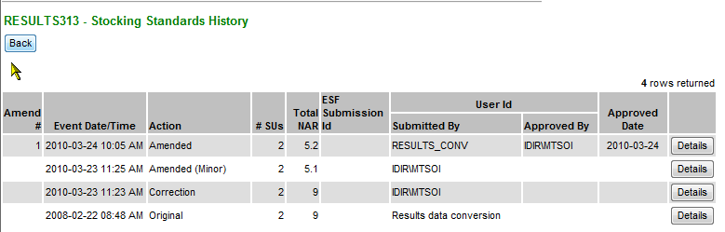
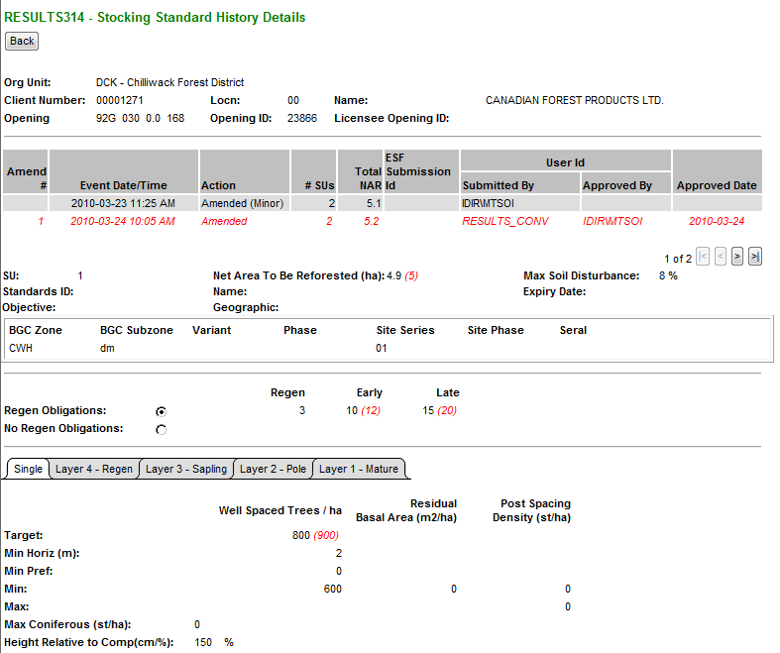
RESULTS – SU History
Upon Approval – Status changed to “APP”
All changes from the Amendment is now reflected.
SU History & History contains Audited changes.
Changes items from the Action is in (red).
Only has changes effective March 11, 2008 (date which this infrastructure was created)

Slide 40
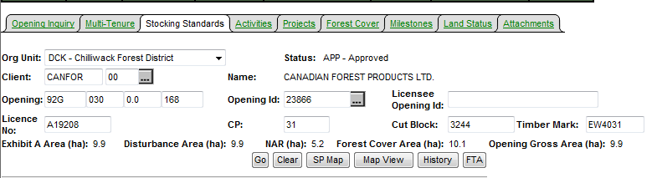
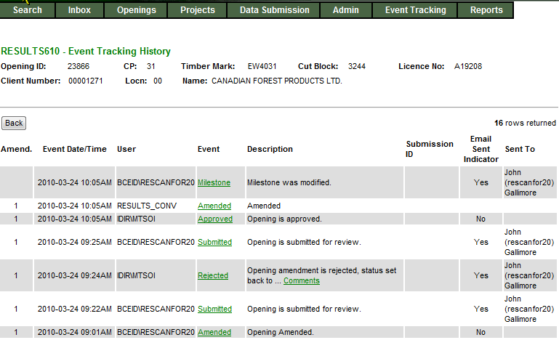
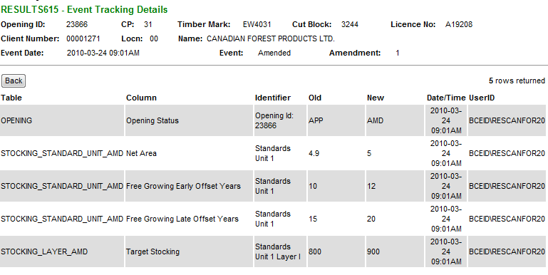
Auditing – History
S610 History provides each of event.
SU History data can also be accessed from S610.
History provides tracking of individual element changed

Slide 41
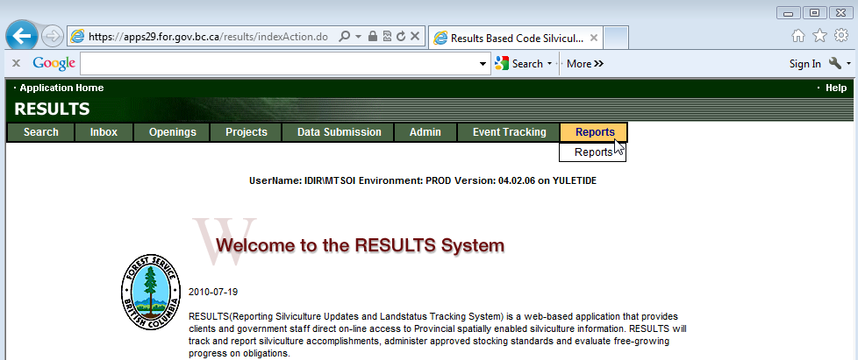
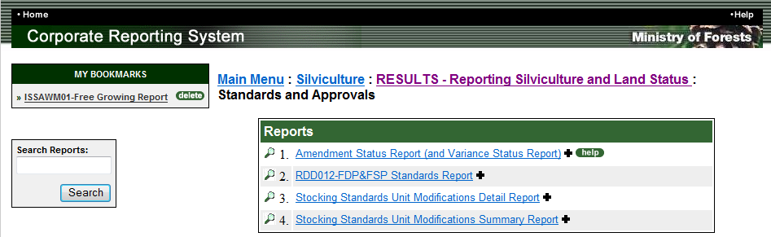
RESULTS – CRS Reports SU History
Stocking Standard Modification Detail and Summary Reports are effective March 11, 2008 based on SU History function in RESULTS.
Any SU Modifications prior to this date is not reported via SU History function but information is available via Event History.

Slide 42
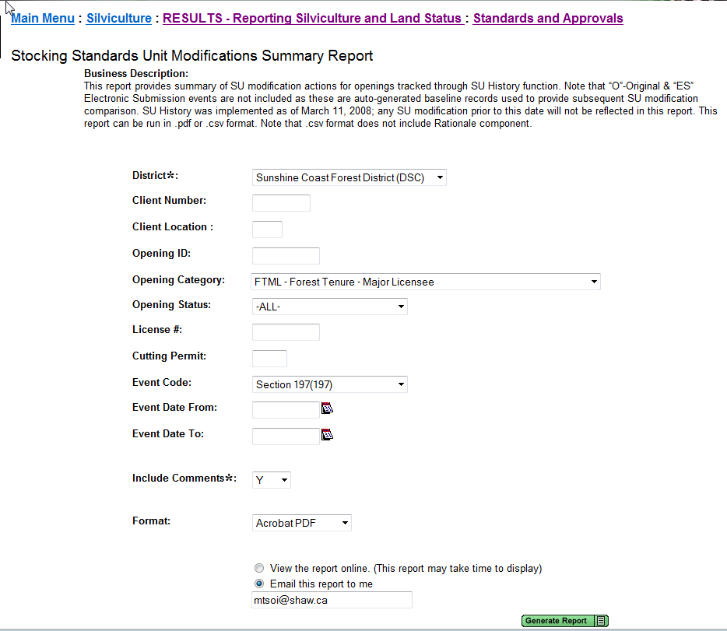
RESULTS – SU Modification Summary
Format CSV or PDF

Slide 43
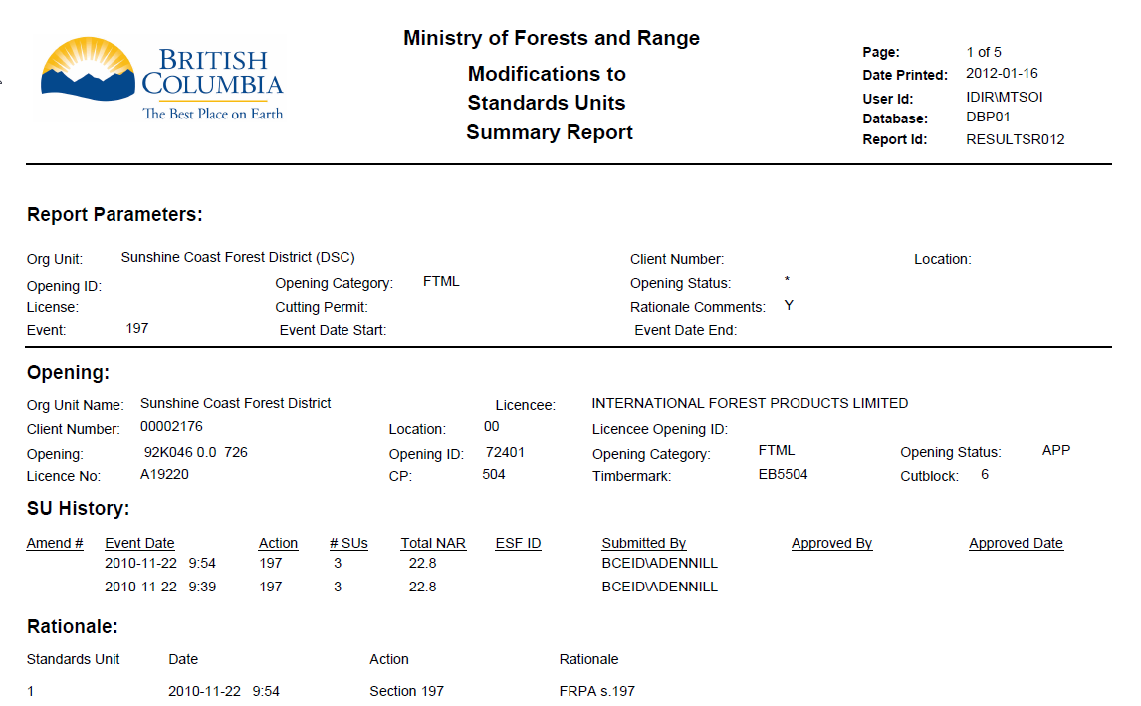
RESULTS – SU Modification Summary

Slide 44
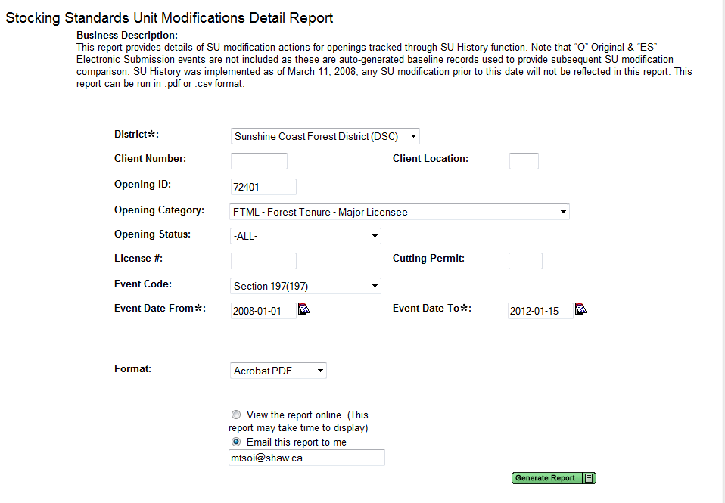
RESULTS – SU Modification Detail
Format CSV - but only View Online
PDF – View Online or Email

Slide 45
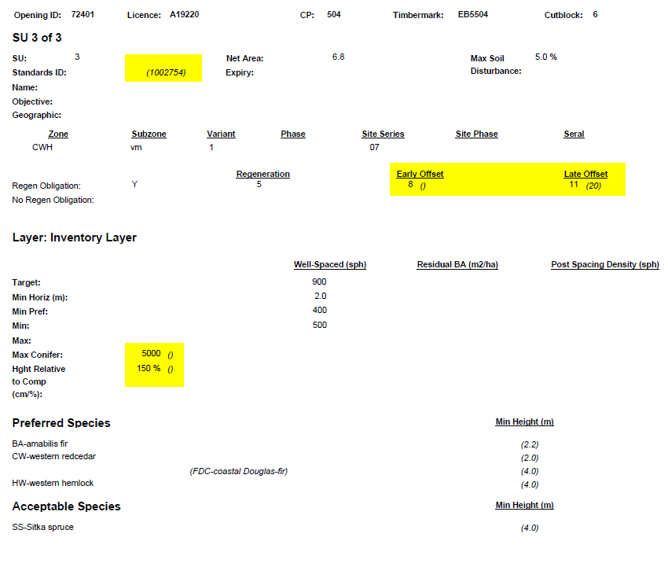
RESULTS – SU Modification Detail
Changes based on action will be in (brackets and italized)

Slide 46
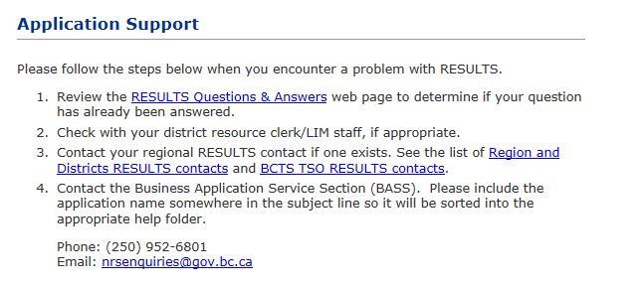
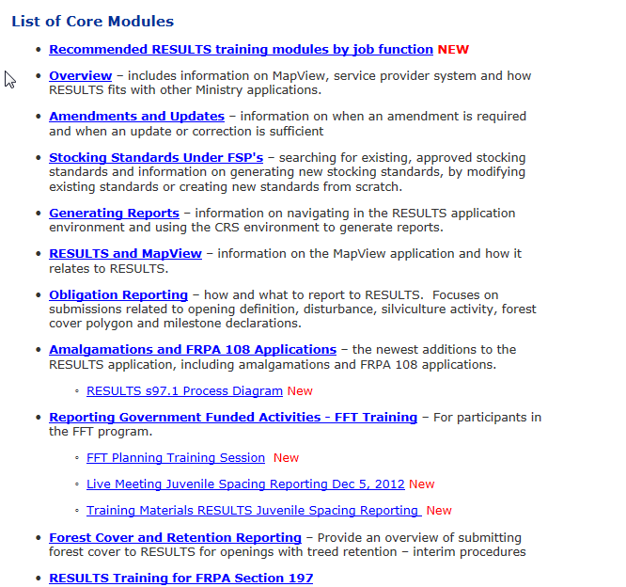
Help Resources
http://www.for.gov.bc.ca/his/results/support.htm
http://www.for.gov.bc.ca/his/results/training/index.htm
E-Stand Enhancement

